Slide 1
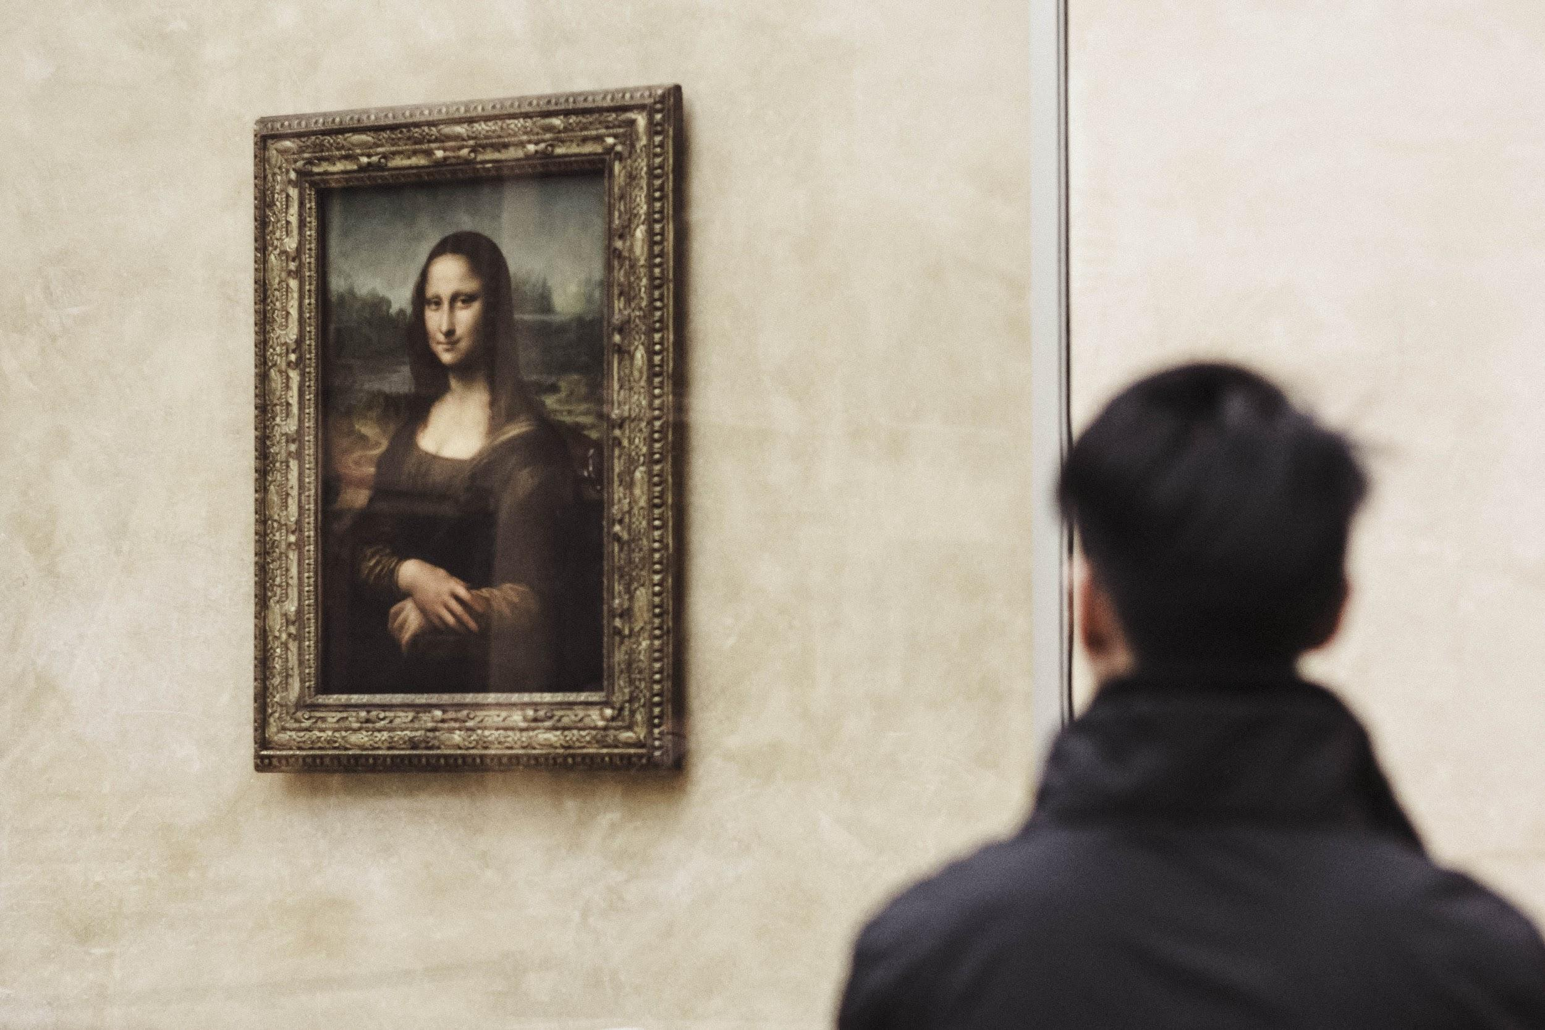
PREDICTING ARTIST FROM ARTWORK
ABHIJIT KRISHNA MENON(00142550)

Slide 2
INTRODUCTION
Artwork is one of the most abstract ways of expressing oneself. As someone who is not a huge fan of art or very appreciative of it, I have always wondered how people distinguish between the styles of various artists and painters.
Given that image processing takes a lot of computation power, I felt that this project would be best suited to show the true change, higher and parallel computation brings about while training a Machine learning model.

Slide 3
FLOW OF THE PROJECT
DATA MODELLING ACROSS DIFFERENT HARDWARE
DATA PRE-PROCESSING
RESULTS AND ANALYSIS
CONCLUSION AND FUTURE STEPS

Slide 4
DATA AND DATA PREPROCESSING

Slide 5

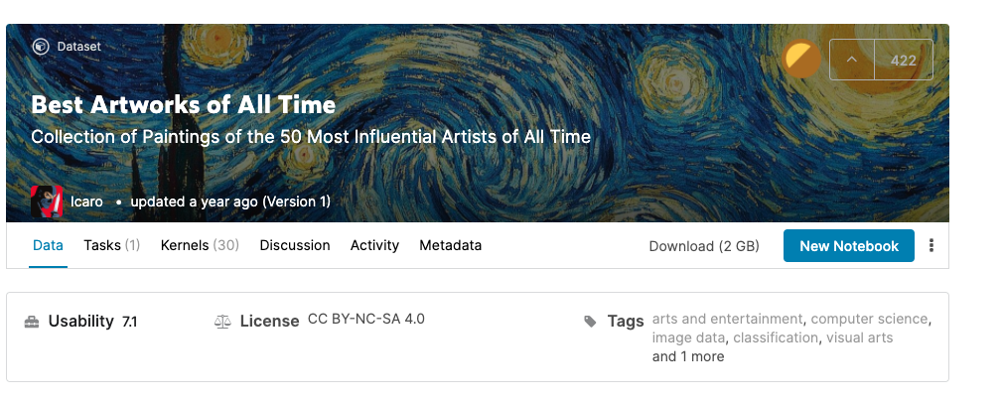
BEST ARTWORK OF ALL TIME
The source of the data is Best Art Work of All Time - Dataset from Kaggle.
The size of the dataset is 2GB.
This data set contains three files.
– artists.csv: data set of information for each artist.
– images.zip: collection of images (full size), divided in folders and sequentially numbered.
– resized.zip: same collection but images have been resized and extracted from folder structure

Slide 6
PREPROCESSING
Preprocessing of the image data involved the following:
Labelling the image data on the basis of the folder directory.
Normalising the image data.
Zooming into the image for the input to avoid any null areas there might be in the jpg.
Passed data through a generator to develop inputs for training and validation.

Slide 7
Data Modelling on multiple Hardware.
Northeastern Discovery Cluster
Tesla 80 GPU
Google CoLab Pro
Tesla 40C GPU
Google CoLab Pro
2vCPU @ 2.2GHz
Mac Book Pro
12.2 GHz 6-Core Intel Core i7

Slide 8
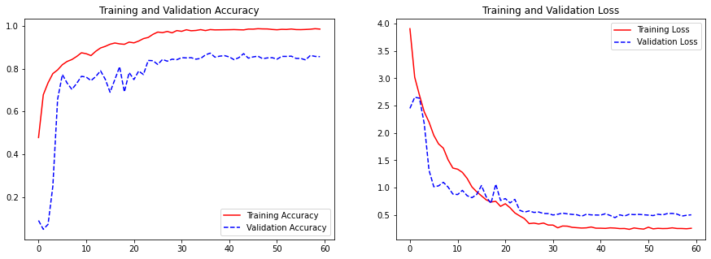

Slide 9
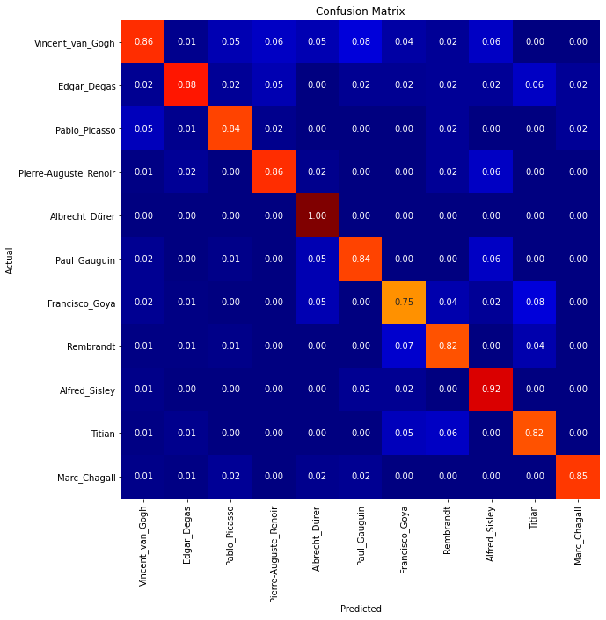
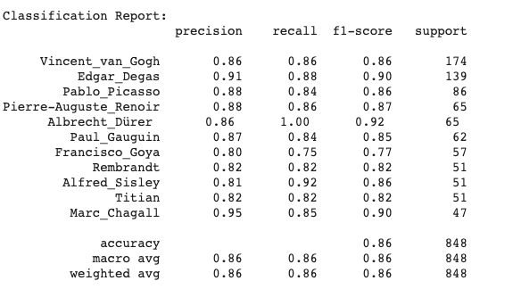

Slide 10
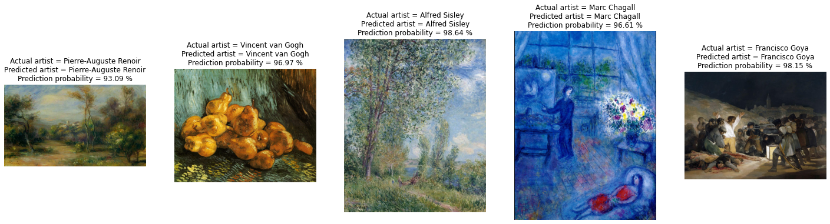
Predicted Paintings

Slide 11
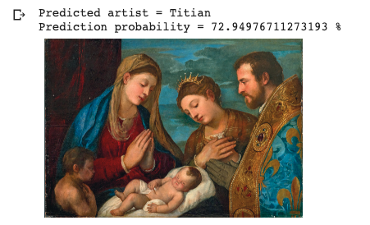
Predicted Picture From the Internet.

Slide 12
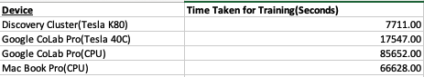
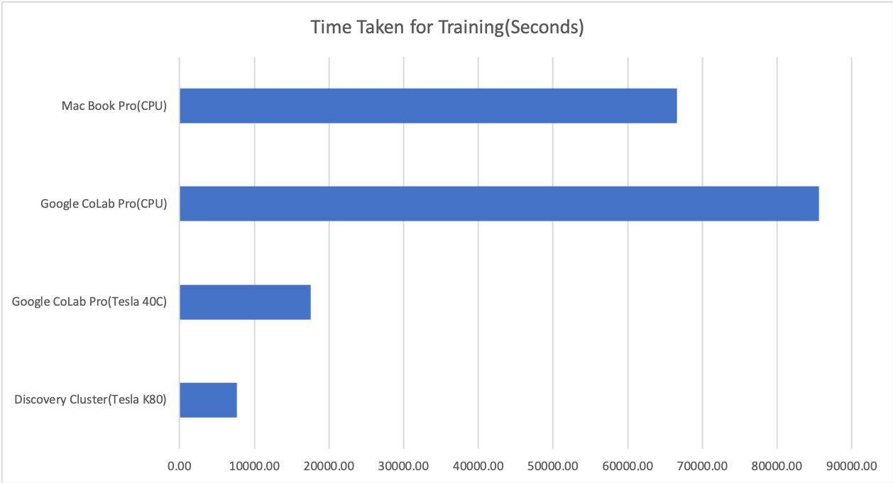
Hardware Performance Comparison

Slide 13
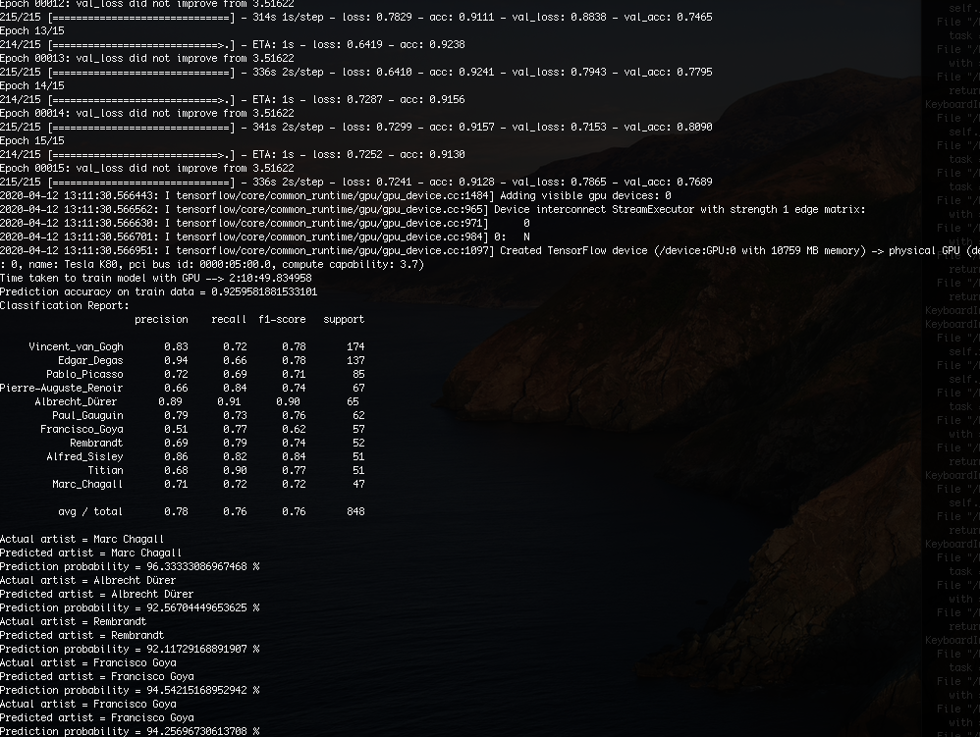
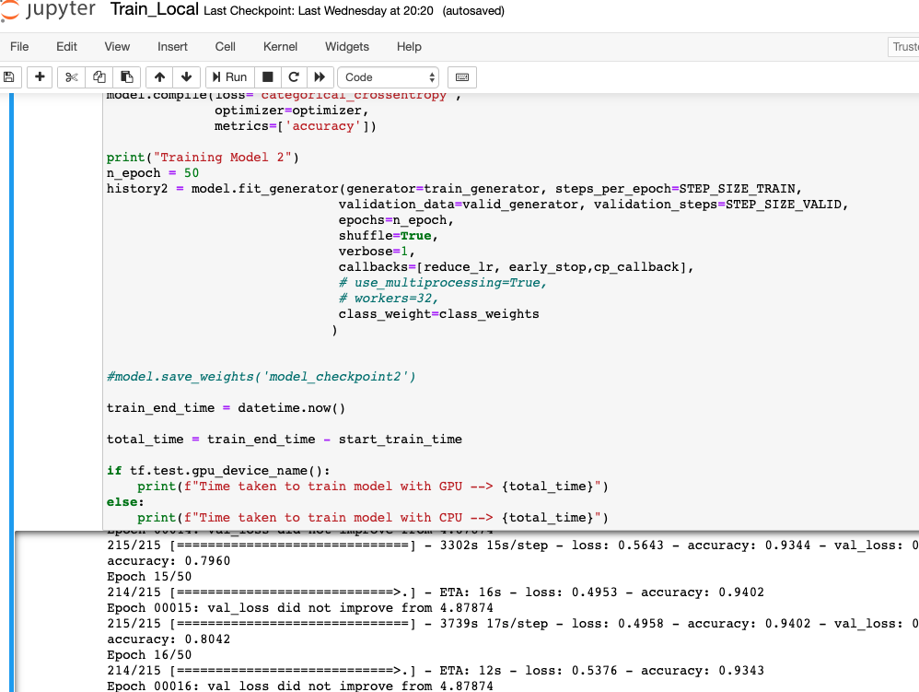
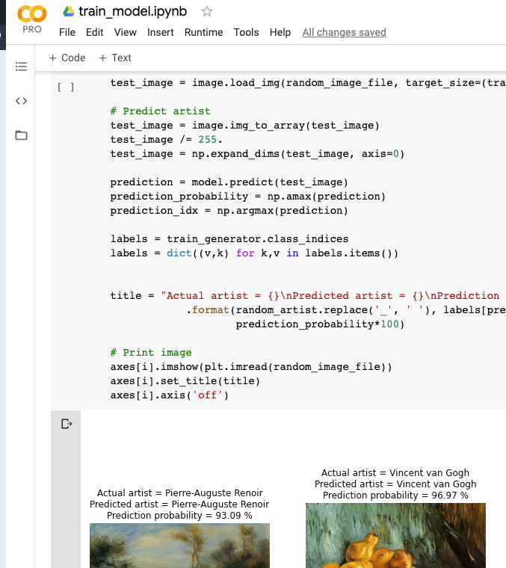

Slide 14
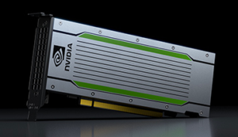
Conclusion
From the experiment performed to test the performance of these various hardware specifications on the training of the Machine Learning model in question, we can conclude that the Tesla 40C GPU provided by the Google CoLab Pro performs the most efficiently amongst all the 4 candidates.

Slide 15
Future Steps
Build a more dense model given better processing power.
Train on a larger dataset consisting of more artists and their painting.
Build a web app and deploy the project.

